Slide 1
Retail Giant Sales Forecasting Assignment -BY KUNAL KATORE

Slide 2
Business Problem Statement
Global Mart is an online supergiant store that has worldwide
operations. This store takes orders and delivers across the globe and
deals with all the major product categories consumer, corporate,
and home office.
As a sales manager for this store, you have to forecast the sales of the
products for the next 6 months, so that you have a proper estimate and
can plan your inventory and business processes accordingly.

Slide 3
STEPS
Import necessary libraries
Import shared sample time
series data
Data Preparation
The most profitable market segment using COV
Time Series Analysis
Building models to forecast sales and quantity for the most profitable market segment
Finding the optimum method in Smoothing Techniques and ARIMA Techniques
Conclusion:The most suitable model, is based on the MAPE value comparison.

Slide 4
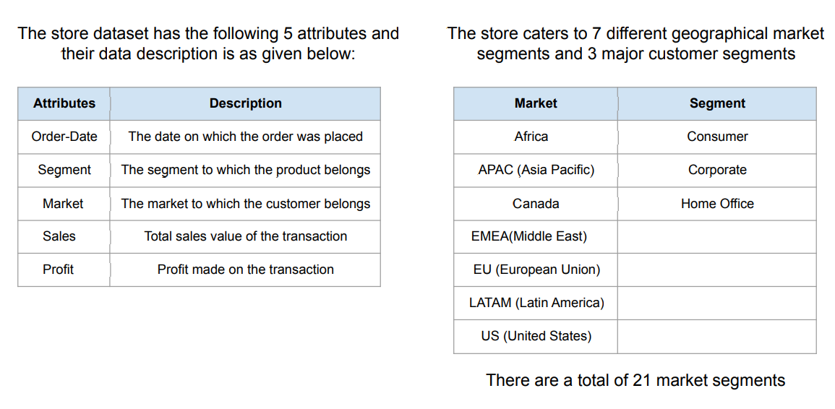
DATA DESCRIPTION

Slide 5
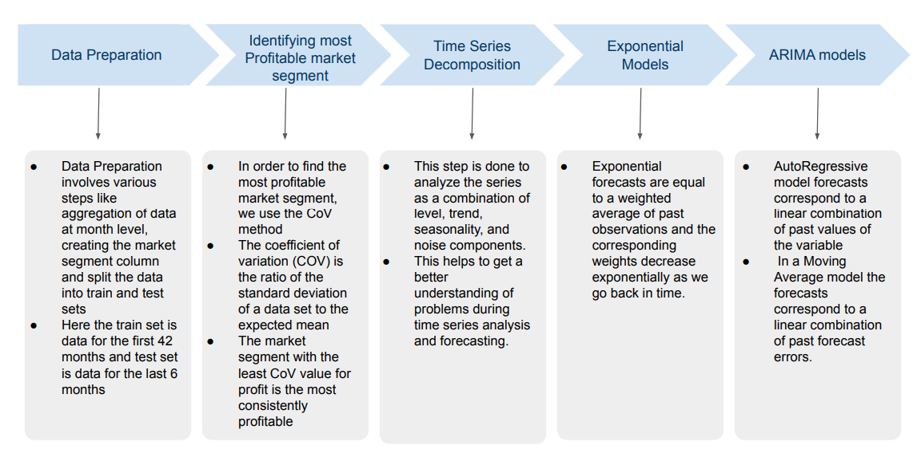
ANALYSIS APPROCH

Slide 6
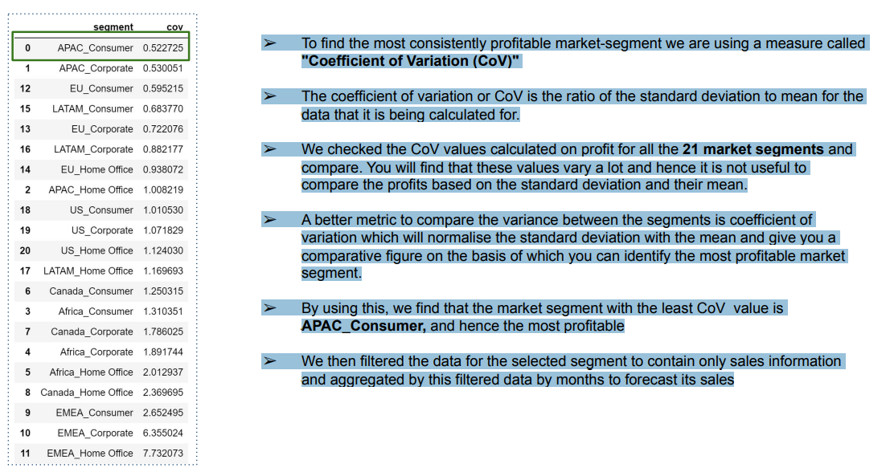
MOST PROFITABLE SEGMENT

Slide 7
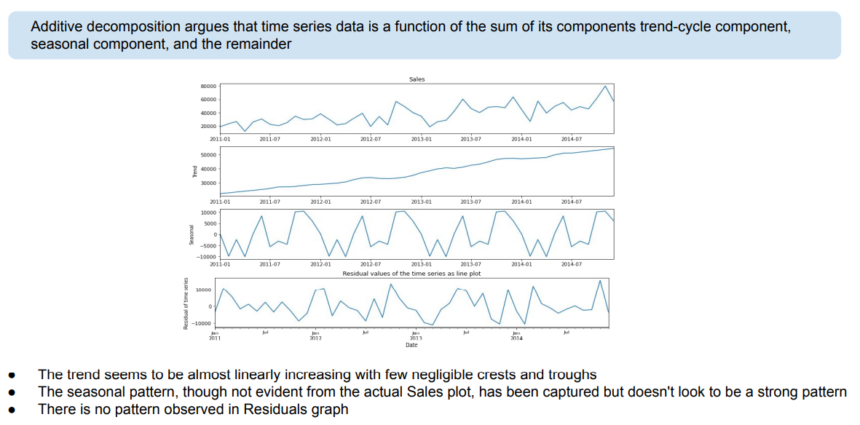
TIME SERIES DECOMPOSTION- ADDITIVE

Slide 8
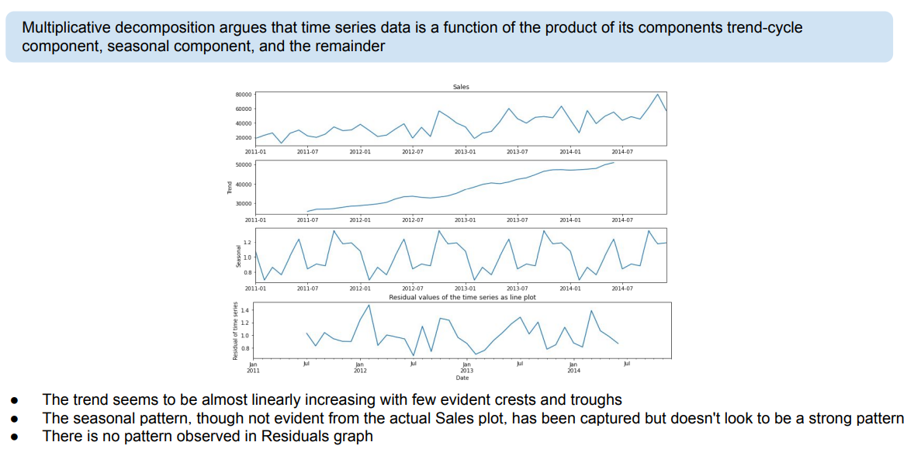
TIME SERIES DECOMPOSTION- MULTIPLICATIVE

Slide 9
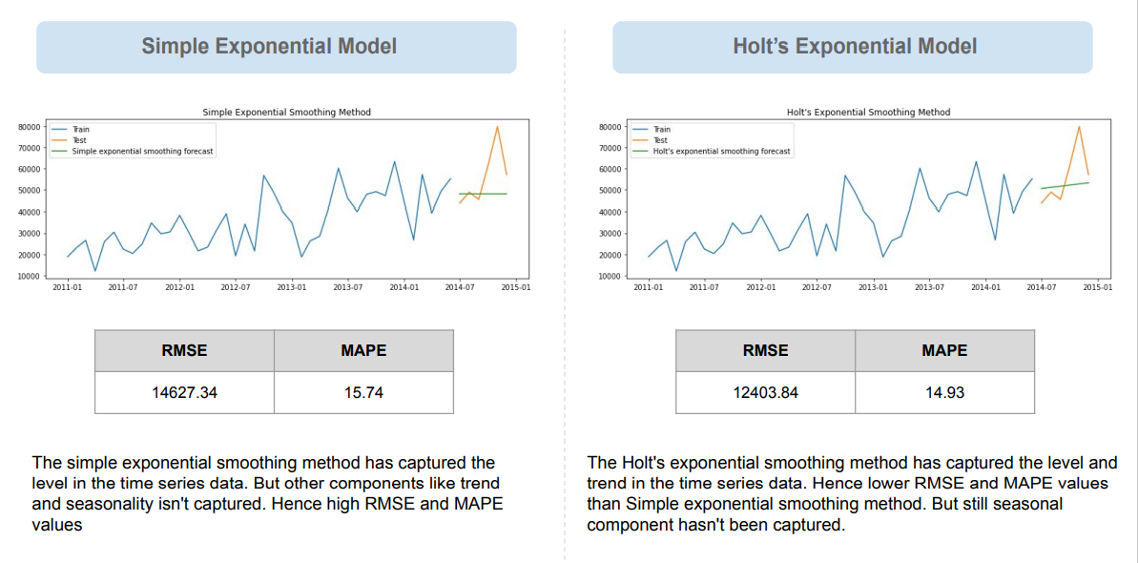
EXPONENTIAL MODEL- 1

Slide 10
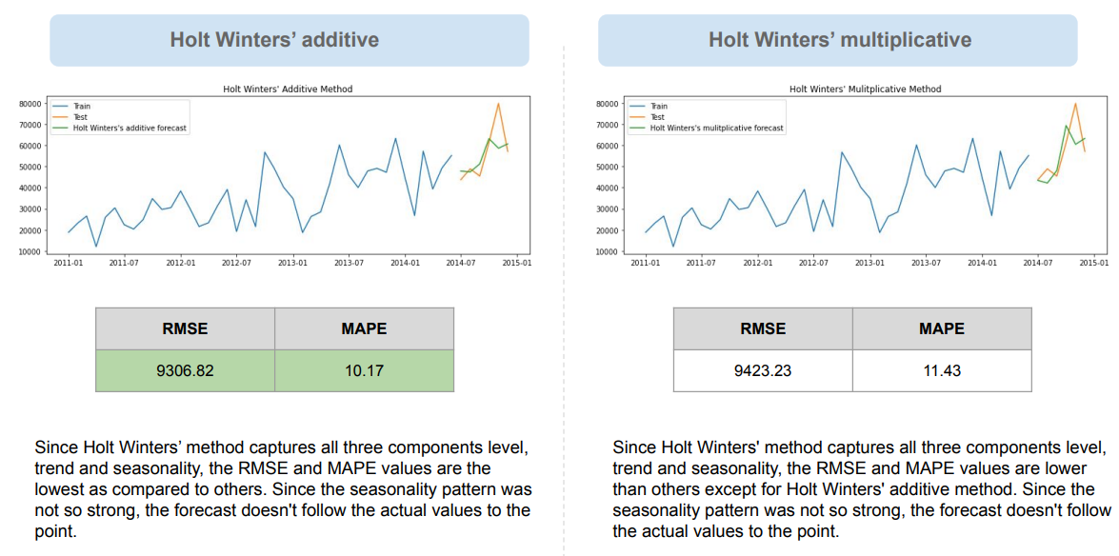
EXPONENTIAL MODEL- 2

Slide 11
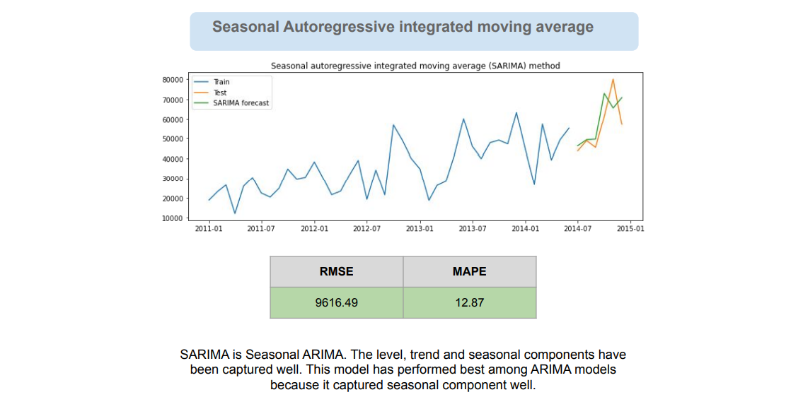
ARIMA MODEL

Slide 12
CONCLUSION
We tested different Exponential Models and ARIMA models on the Retail Giant Sales dataset.
Among exponential models, Holt Winters' additive model performed the best as seasonal component is captured in this model and was captured well.
Among ARIMA models, SARIMA model performed the best as seasonal component is captured in this model and was captured well.
All in all, even if trend and level components were captured by some models, the capture of seasonal component decreased the RMSE and MAPE to a great extent.

